Slide 1
Using Bootstrap, Images & Animation
Project Members
1.B.V.S.Karthik reddy
2.Uma Mahesh kumar
3.Sunkara Sai Saketh
4.Valluru aAkash
5.Lakshmi vancha

Slide 2
Introduction to Bootstrap
Bootstrap is a free front-end framework .
It includes HTML and CSS as well as Java-Script plug-ins .
It has the ability to create responsive design .
History : Developed by Mark Otto and Jacob Thornton at Twitter .
Advantages of Bootstrap .

Slide 3
Introduction to CSS Images
Bootstrap provides classes that can be used to apply some simple styles to images .
Types of Image styles
Responsive images

Slide 4
Introduction to CSS Animation
CSS animations allows animation of most HTML elements without using JavaScript or Flash!
An animation lets an element gradually change from one style to another.
Keyframes hold what styles the element will have at certain times.
Types of animation styles .
Running an animation .
Animation fill-mode properties specifies the style for target element when animation doesn’t play .

Slide 5
Bootstrap
Bootstrap is a free front-end framework for faster and easier web development
Bootstrap also gives you the ability to easily create responsive designs
Bootstrap includes HTML and CSS based design templates for typography, forms, buttons, tables, navigation, modals, image carousels and many other, as well as optional javascript plugins
In June 2014 bootstrap was the no.1 project on GitHub!

Slide 6
Advantages of Bootstrap
Easy to use
Responsive features
Mobile-first approach
Browser compatibility

Slide 7
Bootstrap Installation
Two ways to download Bootstrap:
Download bootstrap from getbootstrap.com
Include bootstrap from a CDN

Slide 8
Basic Structure of Bootstrap
<div class="container-fluid"> <h1>my first bootstrap page</h1> <p>this is some text.</p>
<div class="row"> <div class="col-*-*"></div> <div class="col-*-*"></div> </div> <div class="row"> <div class="col-*-*"></div> <div class="col-*-*"></div> <div class="col-*-*"></div> </div> </div>

Slide 9
CSS Images
Image position
Image rounding
Image opacity
Responsive Images

Slide 10
What is CSS Animation ?
To animate transitions from one CSS style configuration to another.
Animations consists of two components
A style describing the CSS animation
Set of Keyframes that indicates start and end of animation’s style as well as intermediate waypoints .

Slide 11
Sub-properties of Animation
Animation-delay
Animation-direction
Animation-duration
Animation-fill-mode
Animation-iteration-count
Animation-name
Animation-play-state
Animation-timing-function

Slide 12
Advantages of CSS animations over Traditional Script driven animations :
Easy to use, create them without knowing JavaScript
The animations run well even under moderate system load.
Browser control the animation sequence lets the browser optimize performance and efficiency.
Ex: Reducing the update frequency of animations running in tabs that aren’t currently visible.

Slide 13
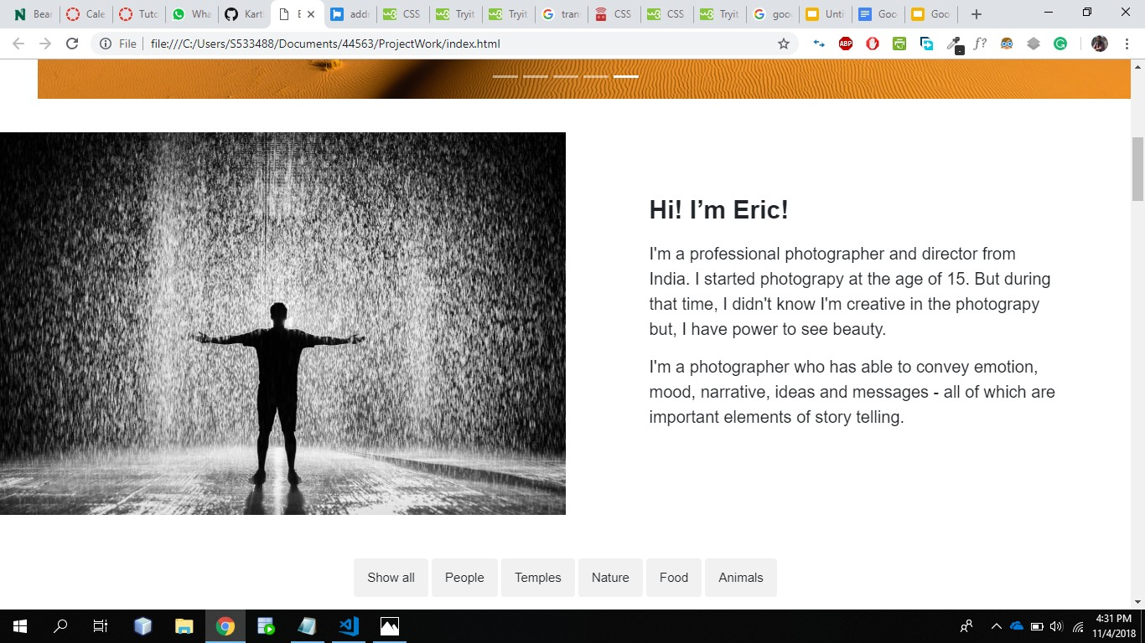
Demo
GitHubLinK- https://github.com/KarthikBijjam/Project

Slide 14
REFERENCES
W3 Schools
Font Awesome
Google Fonts
Unplash.com
Pixels.com
justinaguilar.com

Slide 15


Slide 16


